Slide 1
CS 316: Introduction to Deep Learning
Optimization
Week 8
Dr Abdul Samad

Slide 2
Lecture Outline
Optimization Problems
Local and Global Minima
Convex Set
First-order condition
Second-order condition
Convex and Non-convex examples
Convex Optimization
Gradient Descent
Stochastic Gradient Descent
Mini Batch Stochastic Gradient Descent
Visualization of different Optimization Algorithms

Slide 3
Optimization Problems
The general form of optimization problems is as follows:
Cost function
Constraint set example
Unconstraint if

Slide 4
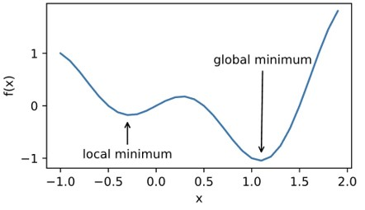
Local and Global Minima
Most optimization problems have no closed form solution.
We then aim to find a minima through iterative methods
Global minima
Local minima , there exists
Figure source: Local and Global Minima

Slide 5
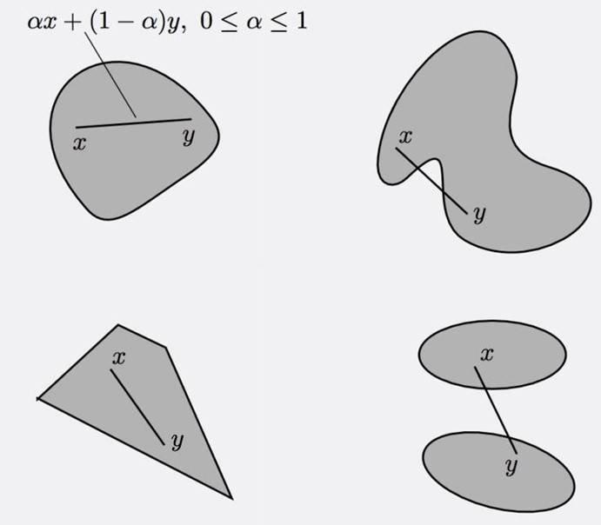

Convex Set
A subset of is called Convex if
Figure Source: Convex Set

Slide 6
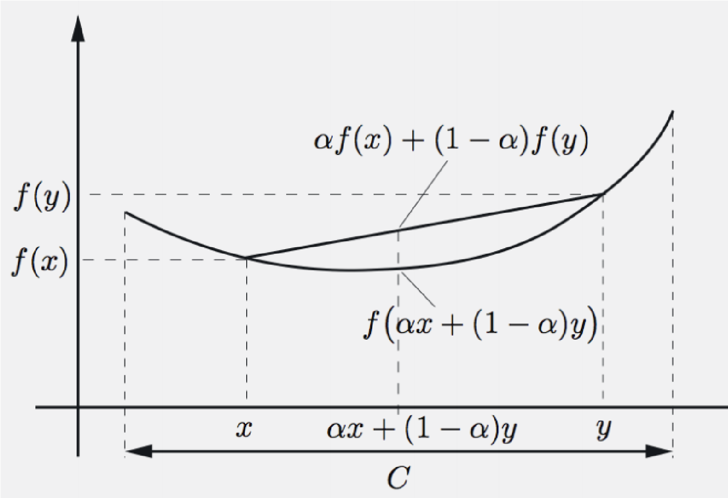

Convex Function
is called convex if
If the inequality is strict whenever and , then is called strictly convex.
Figure Source: Convex Function

Slide 7
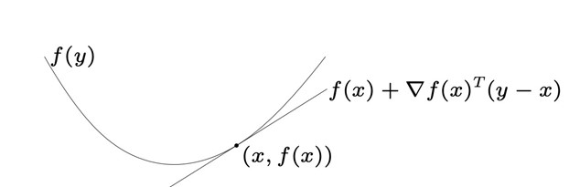
First-order Condition
f is convex if and only if
If the inequality is strict, then f is strictly convex.
Figure Source: First-order condition

Slide 8
Second-order condition
f is convex if and only if
f is strictly convex if and only if

Slide 9
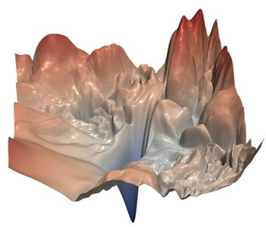

Convex and Non-convex Examples
Convex
Linear Regression
Softmax Regression
Non-convex
Multi-layer perceptron
Convolutional neural networks
Recurrent neural networks
Figure Source: Non-convex

Slide 10
Convex Optimization
If f is a convex function, and C is a convex set, then the problem is called a convex problem.
Any local minima is a global minima.
Unique global minima if strictly convex.
Global minima

Slide 11
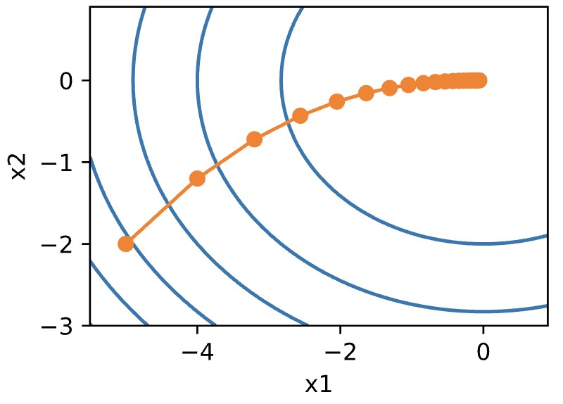
Gradient Descent Algorithm
Choose initial
At time
Figures taken from GD

Slide 12

Stochastic Gradient Descent Algorithm
At time , sample example
Compared to gradient descent
Figures taken from SGD, GD

Slide 13

Mini Stochastic Gradient Descent Algorithm
At time , sample a random subset with

Slide 14
Practical Insights
Do not diminish the learning rate so drastically, we don’t care about optimizing to high accuracy.
Despite converging slowly, SGD is way faster on computing the gradient than GD in each iteration specially for deep learning with large scale datasets.

Slide 15


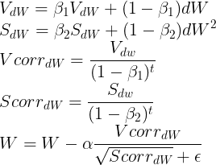
Other variants of Gradient Descent
Momentum
RMSprop
Adam
Live Demo

